Slide 1


Slide 2

SQL SCHEMA

Slide 3
-- Create 'departments' table
CREATE TABLE departments (
id SERIAL PRIMARY KEY,
name VARCHAR(50),
manager_id INT
);
-- Create 'employees' table
CREATE TABLE employees (
id SERIAL PRIMARY KEY,
name VARCHAR(50),
hire_date DATE,
job_title VARCHAR(50),
department_id INT REFERENCES departments(id)
);
-- Create 'projects' table
CREATE TABLE projects (
id SERIAL PRIMARY KEY,
name VARCHAR(50),
start_date DATE,
end_date DATE,
department_id INT REFERENCES departments(id)
);

Slide 4
-- Insert data into 'departments’
INSERT INTO departments(
name, manager_id)
VALUES ('HR', 1), ('IT', 2), ('Sales', 3);
-- Insert data into 'employees’
INSERT INTO employees(
name, hire_date, job_title, department_id)
VALUES ('John Doe', '2018-06-20', 'HR Manager', 1),
('Jane Smith', '2019-07-15', 'IT Manager', 2),
('Alice Johnson', '2020-01-10', 'Sales Manager', 3),
('Bob Miller', '2021-04-30', 'HR Associate', 1),
('Charlie Brown', '2022-10-01', 'IT Associate', 2),
('Dave Davis', '2023-03-15', 'Sales Associate', 3);
-- Insert data into 'projects’
INSERT INTO projects(
name, start_date, end_date, department_id)
VALUES ('HR Project 1', '2023-01-01', '2023-06-30', 1),
('IT Project 1', '2023-02-01', '2023-07-31', 2),
('Sales Project 1', '2023-03-01', '2023-08-31', 3);

Slide 5
UPDATE departments
SET manager_id = (SELECT id FROM employees WHERE name = 'John Doe’)
WHERE name = 'HR’;
UPDATE departments
SET manager_id = (SELECT id FROM employees WHERE name = 'Jane Smith’)
WHERE name = 'IT’;
UPDATE departments
SET manager_id = (SELECT id FROM employees WHERE name = 'Alice Johnson’)
WHERE name = 'Sales';

Slide 6
QUESTIONS
Find the longest ongoing project for each department.
Find all employees who are not managers.
Find all employees who have been hired after the start of a project in their department.
Rank employees within each department based on their hire date (earliest hire gets the highest rank).
Find the duration between the hire date of each employee and the hire date of the next employee hired in the same department.

Slide 7
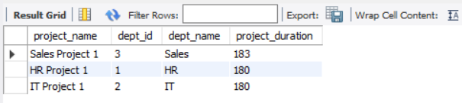
1] Find the longest ongoing project for each department.
SELECT p.name AS project_name, d.id AS dept_id, d.name AS dept_name, DATEDIFF(end_date, start_date) AS project_duration FROM projects p
JOIN departments d ON p.id = d.id
GROUP BY d.id
ORDER BY project_duration DESC;

Slide 8
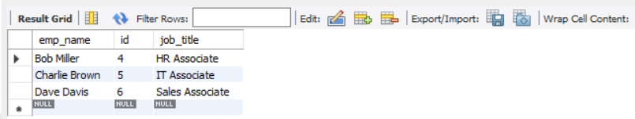
2] Find all employees who are not managers.
SELECT e.name AS emp_name, e.id, e.job_title FROM employees e
WHERE e.job_title NOT LIKE '%manager%';

Slide 9
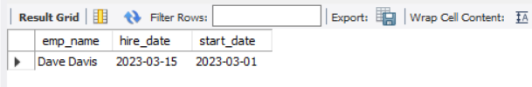
3] Find all employees who have been hired after the start of a project in their department.
SELECT e.name AS emp_name, e.hire_date, p.start_date FROM employees e
JOIN projects p ON e.department_id = p.department_id
WHERE e.hire_date > p.start_date;

Slide 10
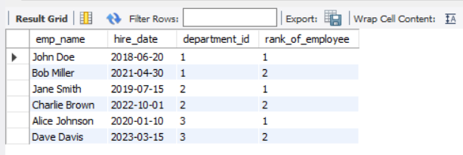
4] Rank employees within each department based on their hire date (earliest hire gets the highest rank).
SELECT name AS emp_name, hire_date, department_id,
RANK() OVER(PARTITION BY department_id ORDER BY hire_date) AS rank_of_employee
FROM employees;

Slide 11
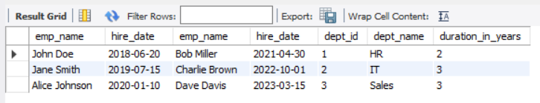
5] Find the duration between the hire date of each employee and the hire date of the next employee hired in the same department.
SELECT e1.name AS emp_name, e1.hire_date, e2.name AS emp_name, e2.hire_date, d.id AS dept_id, d.name AS dept_name, TIMESTAMPDIFF(year, e1.hire_date, e2.hire_date) AS duration_in_years
FROM employees e1
JOIN employees e2 ON e1.department_id = e2.department_id
JOIN departments d ON e1.department_id = d.id AND e2.department_id = d.id
WHERE e2.hire_date > e1.hire_date
ORDER BY e1.department_id, e1.hire_date;

